Slide 1




EXCELSSIOR EDUCATION SOCIETY’S K. C. COLLEGE OF ENGINEERING AND MANAGEMENT STUDIES AND RESEARCH (Affiliated to the University of Mumbai) Mith Bunder Road, Near Hume Pipe, Kopri, Thane(E)-400603
Department of Computer Engineering
Academic Year 2023-24(Odd Semester)

Slide 2
Index
Introduction to Topic
Need of Project
Problem Statement
Literature survey In Tabular Format
Algorithm for Project Development
Block Diagram
Flow-chart
Requirement Hardware and Software
Feasibility Study
Proposed Methodology
Detail Design DFD Diagram
Activity Diagram
Screenshots of GUI
References

Slide 3
Introduction to Topic
In the dynamic landscape of modern organizations, the effective management of human resources is paramount to achieving strategic goals and maintaining a competitive edge. The HR Management System (HRMS) emerges as a comprehensive solution, seamlessly integrating technology and human resource management practices to streamline processes, enhance efficiency, and foster a more strategic approach to workforce management.
The HRMS serves as the central hub for all HR-related activities within an organization, providing a robust platform for managing employee information, recruitment, performance appraisal, training, and more. This system not only automates routine HR tasks but also empowers HR professionals with valuable insights through analytics, aiding in informed decision-making.
In this digital age, HR MANAGEMENT SYSTEM With the advent of technology The HRMS consolidates and centralizes employee data, providing a secure and accessible repository for personal details, qualifications, and performance records.
Facilitating employee development, the HRMS aids in planning, implementing, and tracking training programs to enhance skills and knowledge.
As organizations continue to recognize the strategic importance of their human capital, the HRMS emerges as a critical tool in fostering a positive employee experience, ensuring compliance with regulations, and driving organizational success. This introduction sets the stage for exploring the various dimensions and functionalities of the HR Management System, ultimately contributing to the evolution of modern HR practices within the organization..

Slide 4
Need of Project
The need for a Human Resources (HR) Management System stems from the growing complexity of modern organizations and the crucial role HR plays in managing human capital effectively. Here are some key points highlighting the necessity of such a system:
A Human Resources (HR) Management System serves as a centralized hub for employee information, automating administrative tasks and enabling data-driven decision-making. By ensuring compliance with evolving regulations and streamlining processes like payroll and leave management, it empowers HR professionals to focus on strategic initiatives. Through intuitive self-service portals and enhanced communication channels, it fosters employee engagement and collaboration while adapting to organizational growth and complexity. In essence, it's a vital tool for modern businesses to optimize HR operations, promote transparency, and drive sustainable success through effective talent management
Centralized Data Management: A HR Management System provides a centralized platform to store and manage employee information such as personal details, job history, performance evaluations, training records, and benefits. This centralized database ensures data integrity, security, and accessibility.
Streamlined Processes: Traditional paper-based HR processes can be time-consuming, error-prone, and inefficient. An HR Management System automates routine administrative tasks such as payroll processing, leave management, and employee onboarding, thereby freeing up HR personnel to focus on strategic initiatives.

Slide 5
Problem Statement
Inefficient and disjointed human resources (HR) management processes within our organization hinder productivity, compliance, and employee engagement. Manual handling of tasks such as employee data management, payroll processing, leave tracking, and performance evaluations results in errors, delays, and suboptimal decision-making. Lack of a centralized HR management system leads to data fragmentation, compliance risks, and difficulty in accessing real-time insights for strategic workforce planning. Moreover, the absence of streamlined communication channels and self-service options undermines employee satisfaction and engagement levels. To address these challenges and enhance organizational efficiency, there is a critical need for the implementation of a comprehensive HR management system that integrates seamlessly with existing workflows, ensures regulatory compliance, empowers employees, and enables data-driven decision-making processes.

Slide 6
Literature survey In Tabular Format
Year | Associated Person/People | State of the System
1982 | Walker A.J. | HRIS development: Project team guide to build effective personnel information system
1984 | Beer et al | Defined HRM as those involved in complex decision.
1999 | Robert b. | Calculating return on investment on HR
2005 | Hufelid, M.A | Becker work force of cord card management Human capital to execute strategy
2006 | Behuselid | Strategic HR management, from journal of management
Notes:
2006 Behuselid Strategic HR management, where do we go from here, from journal of management 2005 Hufelid, m.a, Becker Work force of core card management Human capital to execute strategy
1999 Robert b. Calculating return on investment on HR.
1982 Walker A.J. HRIS development: A project team guide to building an effective personnel information system.

Slide 7
Algorithm for Project Development
1.Project Initiation: a. Define project Objectives: Create a HR Management System which helps to maintain records of employee and improve communication.
b. Provide performance reviews as well as track record of hours attended by employee
c. Access resources and timeline feasibility
2. Planning and Design :
a. Design the UI architecture for Admin, HR, Manager and Employee
b. Create a database to maintain all the records and information
c. Make a connection between all the different profiles
3. Development:
a. Build different profiles and features regarding each profile
b. Code in order for these profiles to interact.
c. Implement for each profile to send, receive or update data accordingly
4. Testing:
a. Test the app for functionality, user-friendliness and performance
b. Address and fix any identified issues

Slide 8
Algorithm for Project Development
5. User Testing: a. Conduct beta testing with a small group to gather user feedback. b. Make improvements based on user suggestions.
6. Development: a. Develop the program in order for it to receive, store or update data.
7. Documentation:
a. Documentation app architecture, design decisions and key features. b. Create instructions for user to easily operate.
8. Project Closure:
a. Verify project completion and compliance with standards. b. Archive project data and records.
9. Post- Project Review:
a. Evaluate project performance against objectives.
b. Identify areas for improvement and lessons learned.

Slide 9
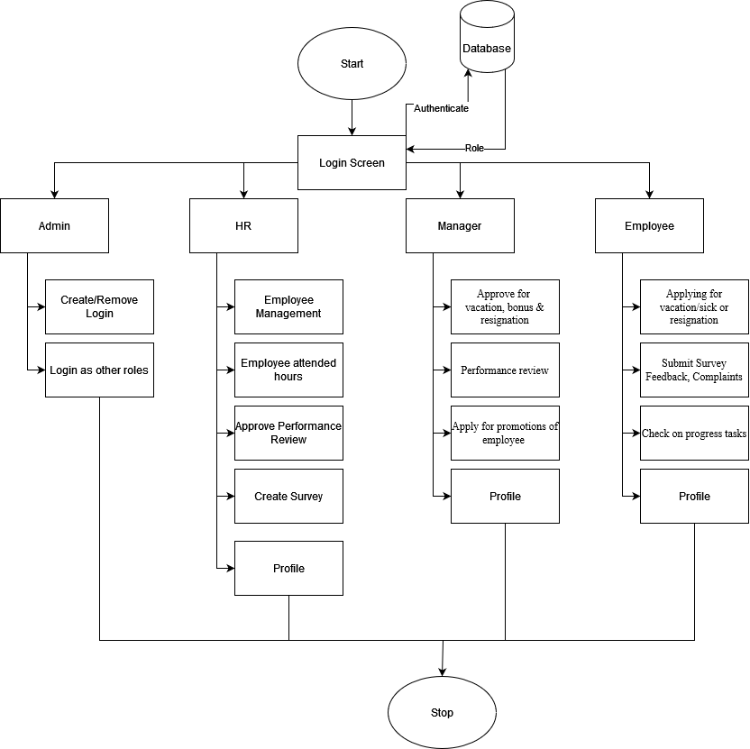
Block Diagram

Slide 10
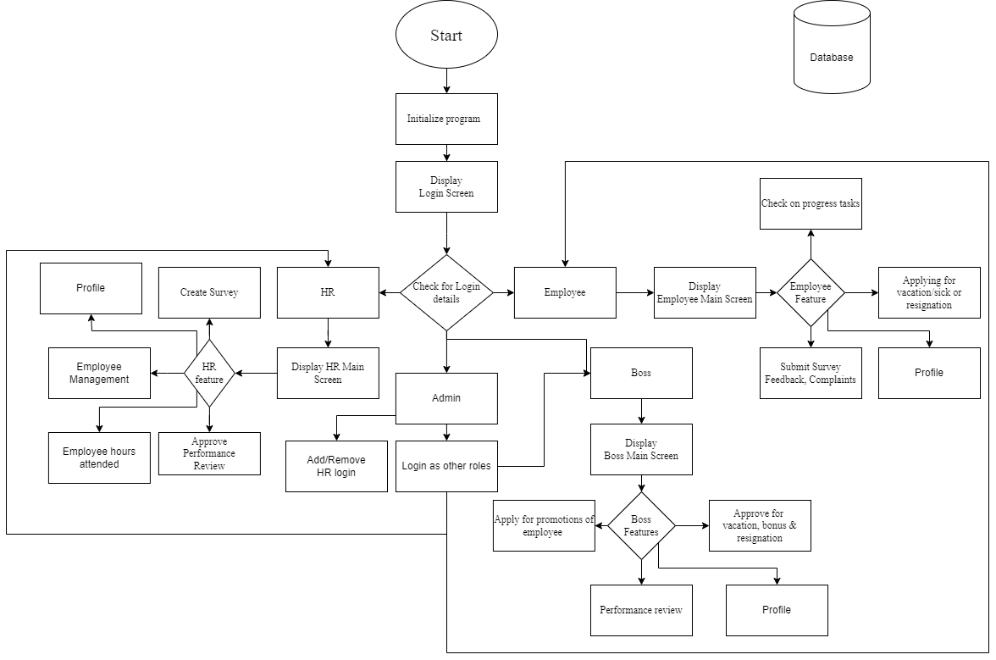
Flow-chart

Slide 11
Requirement Hardware and Software
Hardware :-
Minimum Requirements:
Processor:- Dual core processor @2.4Ghz
Ram:- 4GB Ram
Storage:- 2GB free space
Recommended Requirements:
Processor:- Quad core processor @2.8Ghz
Ram:- 8GB Ram
Storage:- 4GB free space
Software Need as follows: - 1. All Modules of Python should be installed 2. Path of python should be specified 3. OS 10 is required 4. Internet access required
Notes:
Need as follows: 1. All Modules of Python should be installed 2. Path of python should be specified 3. OS 10 is required 4. Internet access required

Slide 12
Feasibility Study
Technical Feasibility:
Python latest module required.
Internet access required.
2. Economic Feasibility:
Development costs are manageable within the allocated budget.
Firebase is cost efficient database to use.
3. Operational Feasibility:
The project aligns with the organization's capabilities and resources.
Integration into existing operations is feasible.
4. Legal and Regulatory Feasibility:
No significant legal barriers are foreseen, and compliance.
5. Scheduling and Time Feasibility:
Project timelines allow for timely development and deployment.
Notes:
a. Python latest module required b. Internet access required

Slide 13
Proposed Methodology
1. User Interface: -
a. Intuitive design for employee self-service and admin dashboards.
b. Responsive and user-friendly interface.
2. Database Management: -
a. Centralized database for secure storage of employee data.
b. Database management system for efficient data retrieval.
3. Application Logic: -
a. Employee Onboarding: Digital forms and document submission.
b. Attendance Tracking & Performance Records
c. Performance Management: Goal setting, feedback mechanisms.
d. Employee Self-Service: Leave requests and personal information.
4. Technologies Used: -
a. Frontend: Python
b. Backend: Python
c. Database: Firebase

Slide 14
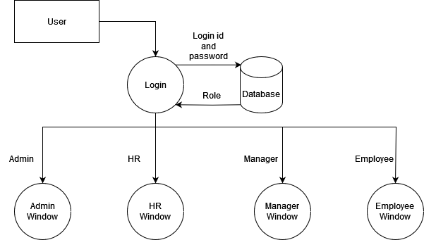
Data Flow Diagram Level 0

Slide 15
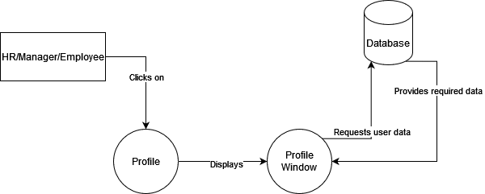
Data Flow Diagram Level 1

Slide 16
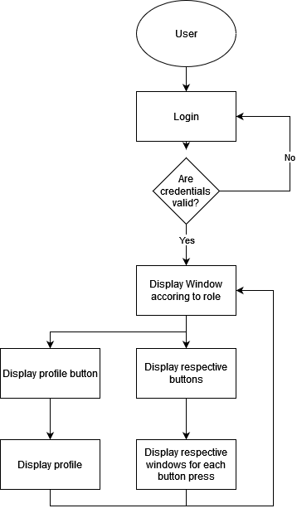
Activity Diagram

Slide 17
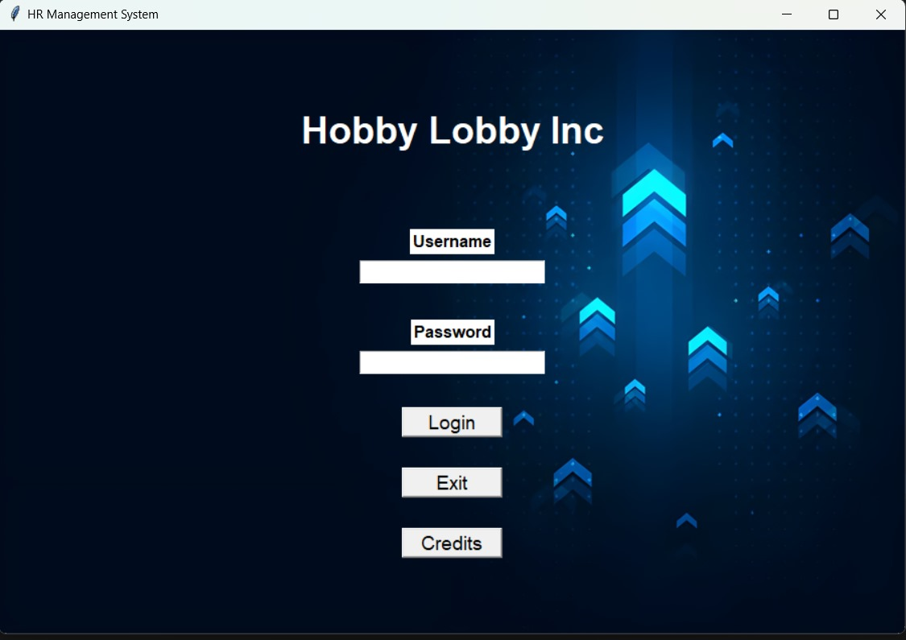
Implementation Details/ Screenshots of GUI
Main Login:
The first page presented to the user upon opening the application, this page gives the input boxes to enter the username and password along with the login button and the exit and credit buttons.
There are 4 types of windows which will open following the user’s login depending on what role has been assigned the user in the DB, the 4 types of logins are Admin, HR, Manager and Employee.
Figure 1

Slide 18
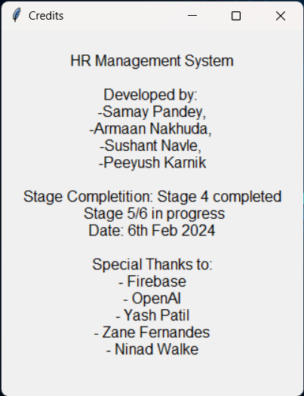
The Credits dialog which opens after clicking the credits button on the main login page.
Figure 2

Slide 19
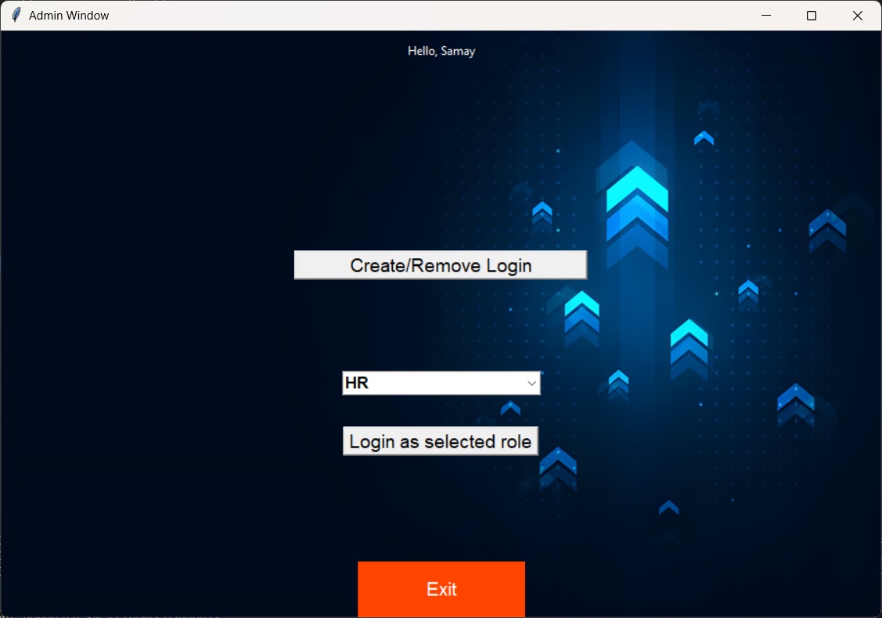
Create/Remove Login: This button will allow the Admin to add or remove logins of HR, Manager or Employee.
Login as Selected Role: The Admin will have an option to simulate as different levels of logins if he/she needs to view or test something as a different permission level.

Slide 20
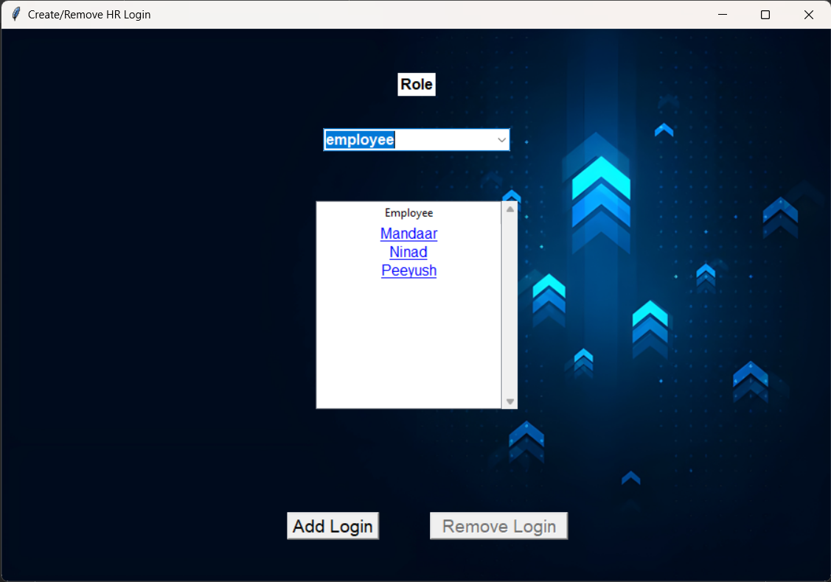
the first screen that is displayed to the user when the Create/Remove button is pressed, this screen gives the Admin the option to select the category of role so the logins of that role are shown, upon it being shown the Admin can select one role and delete it.
Clicking the Add login button, opens a new window

Slide 21
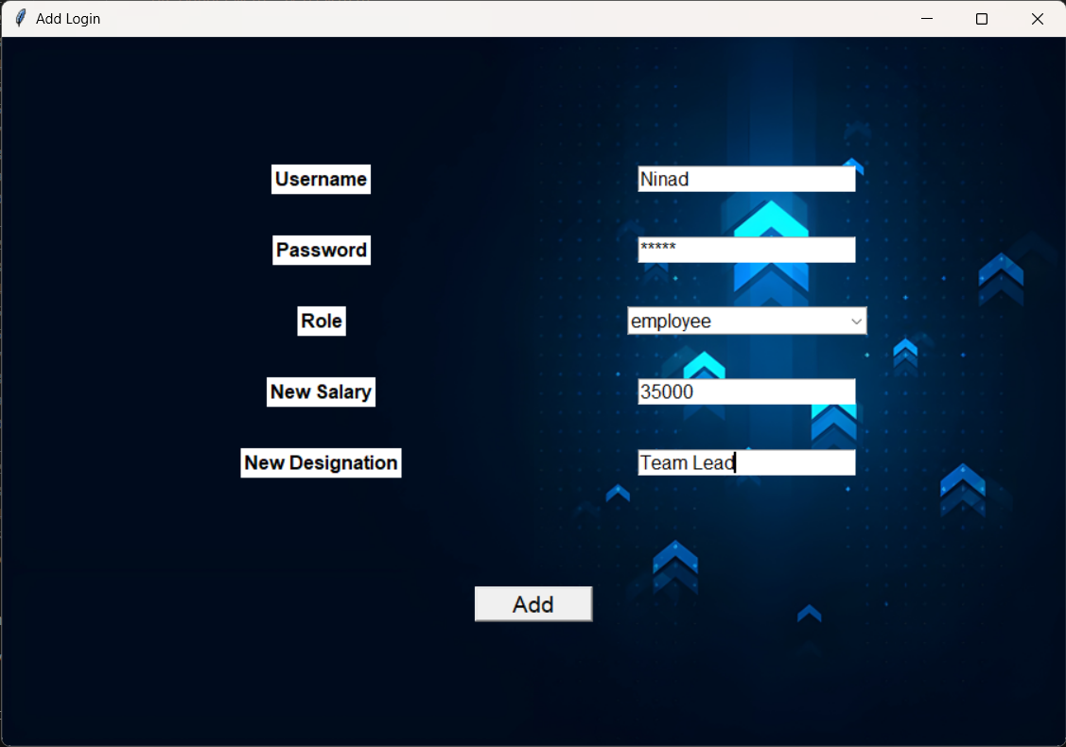
Shows the window to provide details for the new login to be added to the DB.

Slide 22
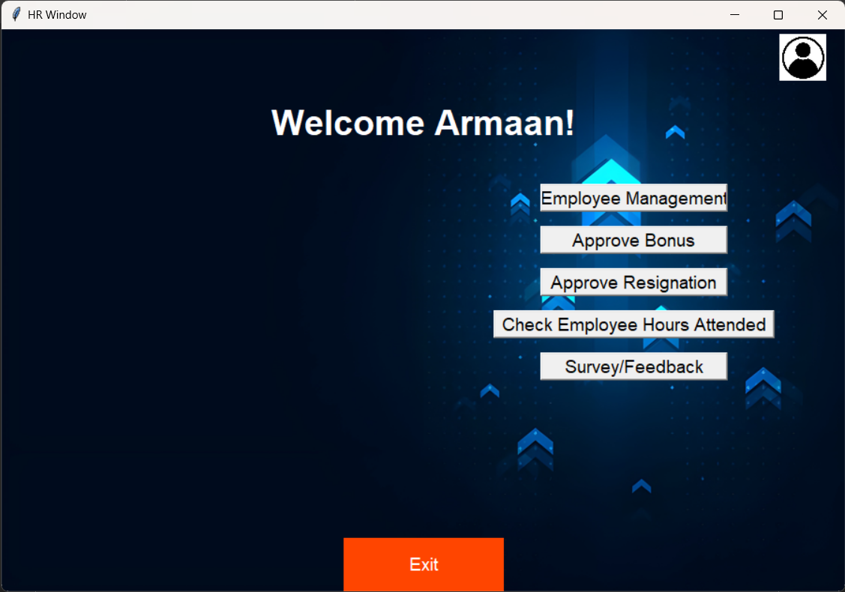
The first screen shown to the HR when the user logins in, it has buttons like employee management to manage Managers and Employees, Approve and assign bonus to employees and Managers respectively, approve resignations for Managers and employees and send out survey with specified questions to the employees to be filled.

Slide 23
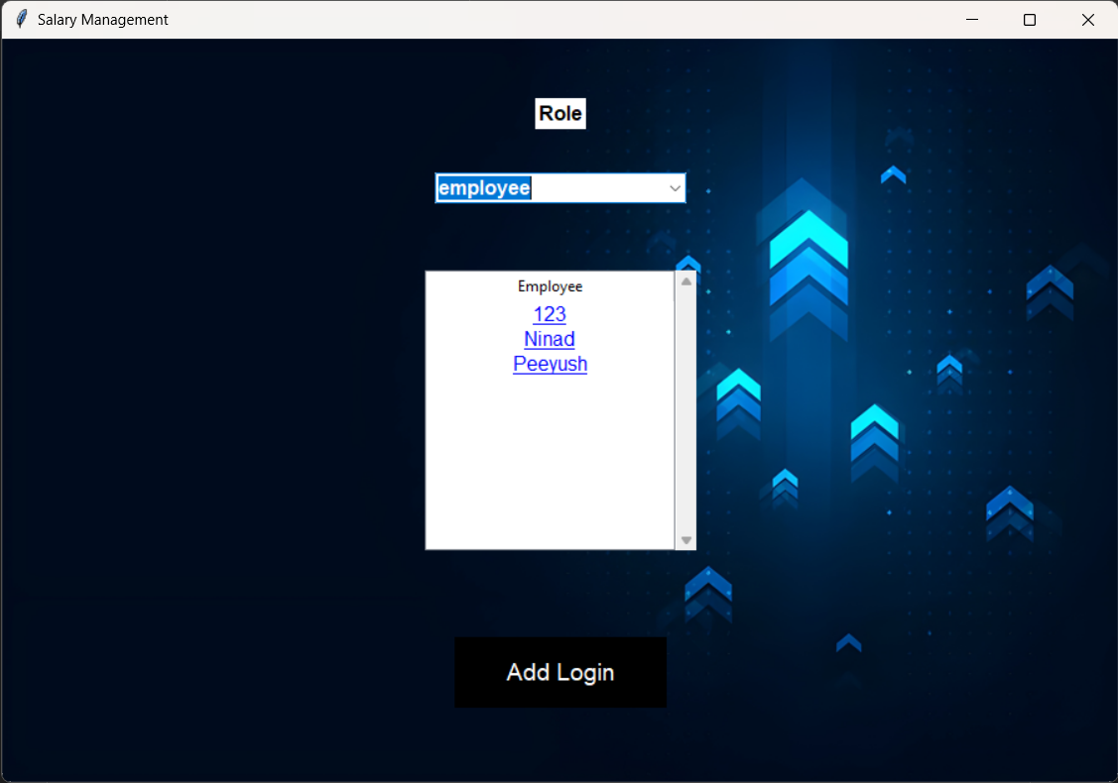
When the Employee Management button is clicked this window will appear to the user which includes a toggle to select the role between manager and employee, upon selecting the role all the logins within that role will show up in the list below, the user can then click on any name to show the details of the employee as shown.
The add login button will open a new window which allows to input the details for the new login as shown before.

Slide 24
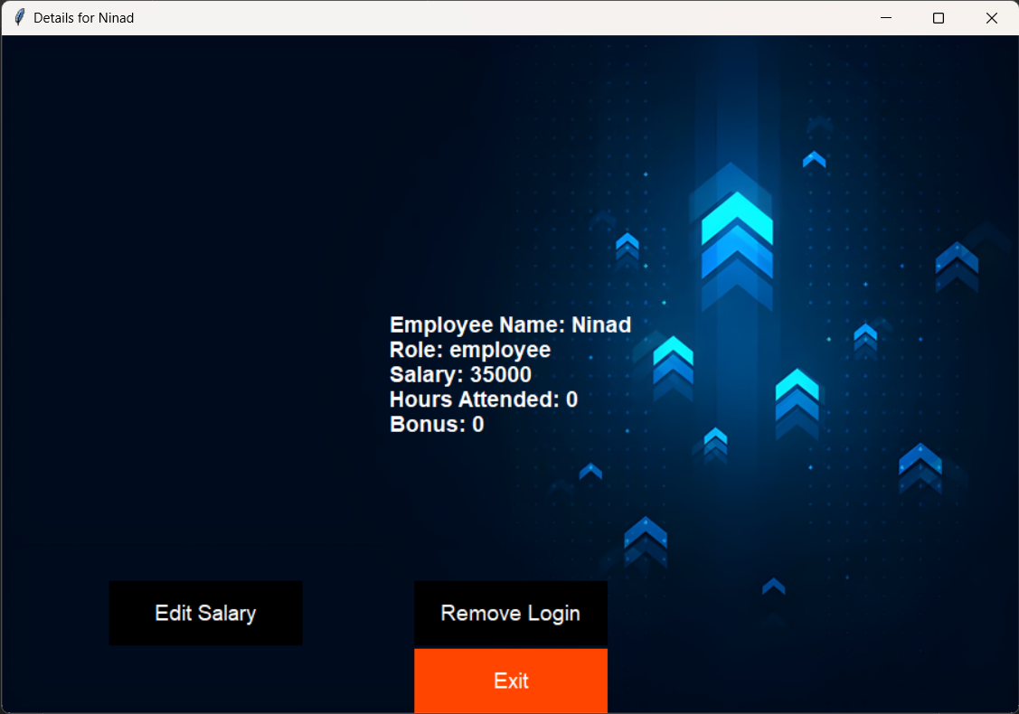
The details of the employee that was clicked is shown in a new window, along with the option to edit the salary and remove the specified login for the employee.

Slide 25
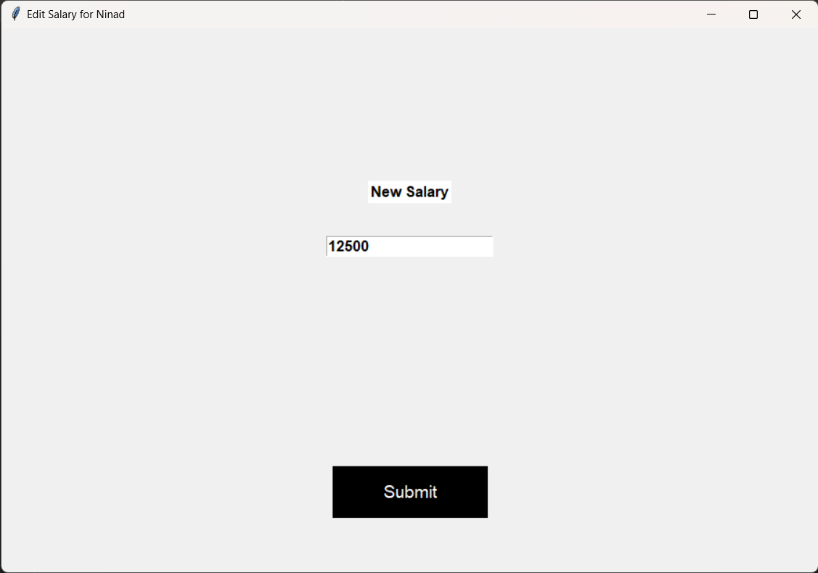
When the user clicks on edit salary button a new window will open asking for the input for the new salary of the Manager/Employee.

Slide 26
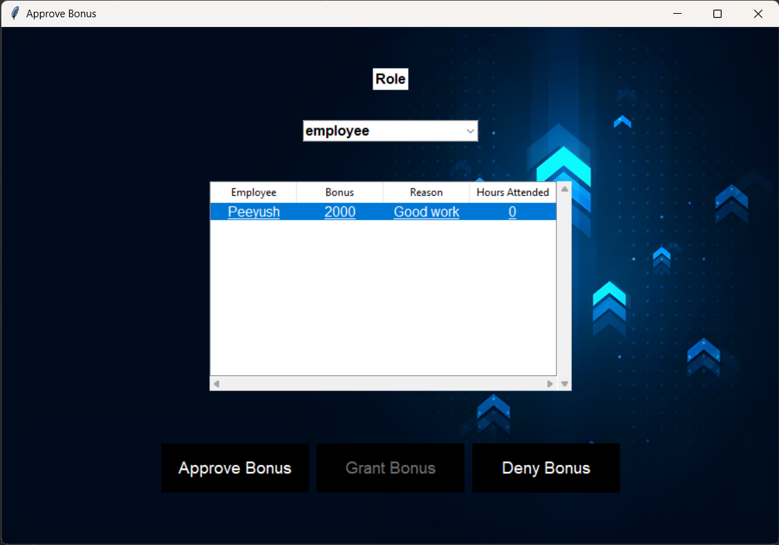
The Employee bonus is requested by the Manager and has to be approved by the HR, giving the HR two options to either approve or deny the request.

Slide 27
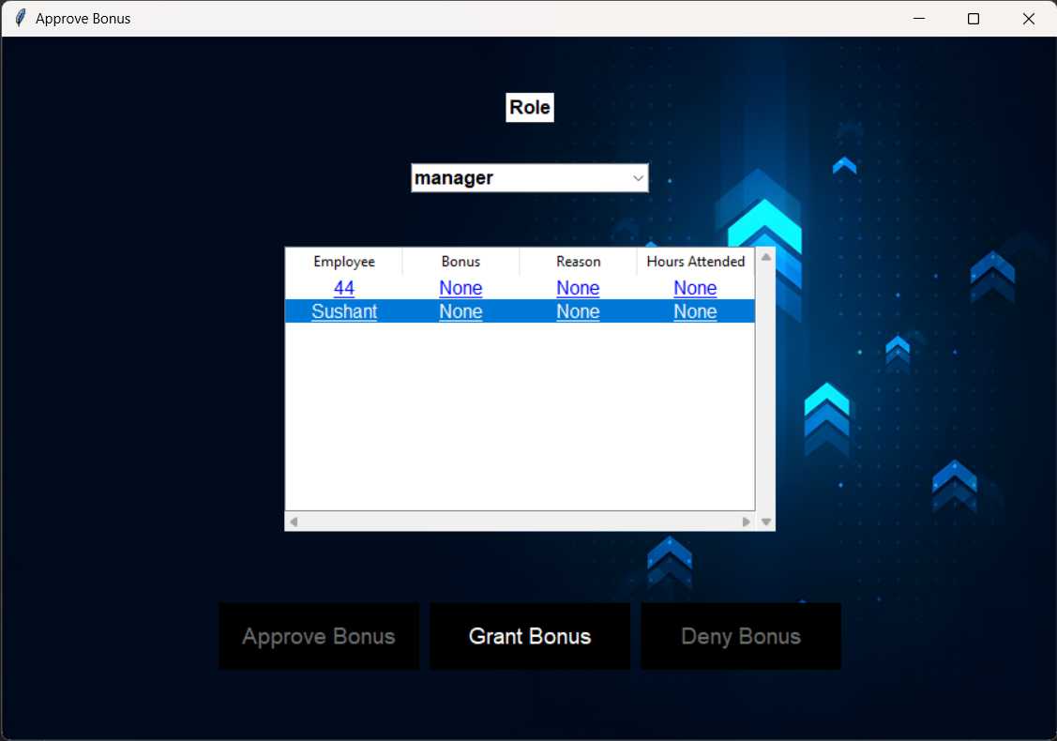
For Manager level the HR directly gives bonus on their discretion, therefore the grant bonus option is available which when clicked opens a new window

Slide 28
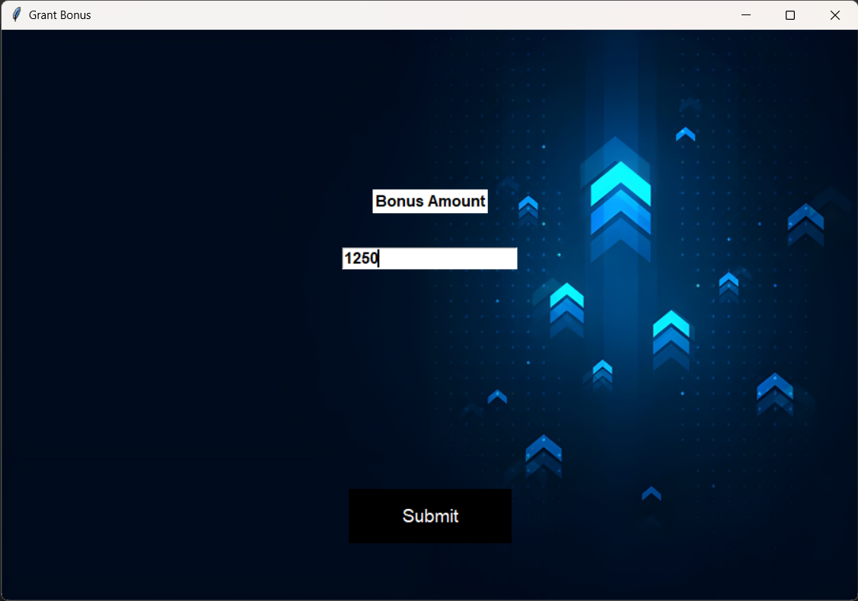
Gives the HR the input box to input the amount of bonus that should be provided the specified Manager, on clicking the submit button (figure 23) is shown.

Slide 29
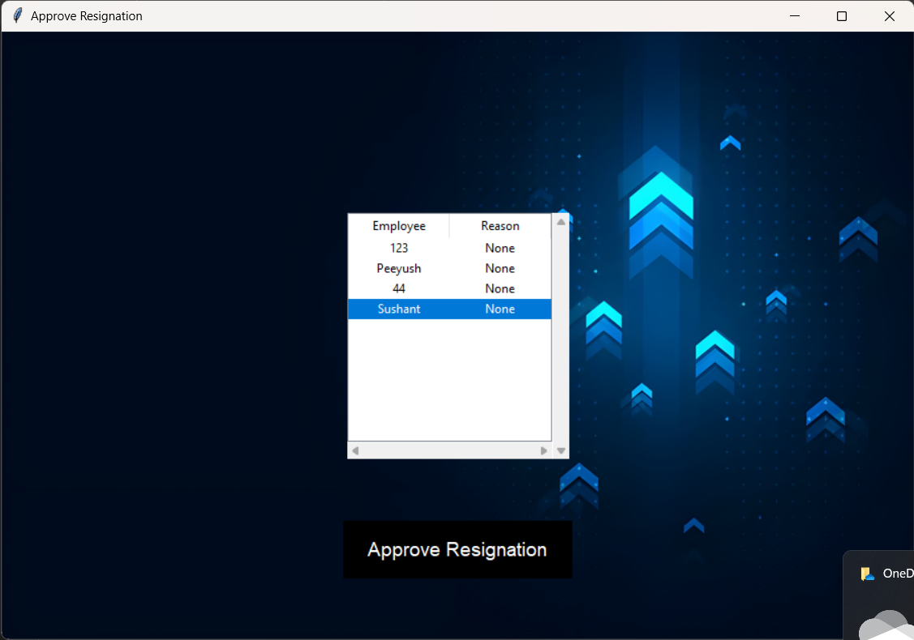
Upon clicking the Approve resignation button a new window shows up with the list of employees whose resignation approval is pending, upon clicking the respective employee the approve button highlights itself which can then be clicked to approve the resignation.

Slide 30
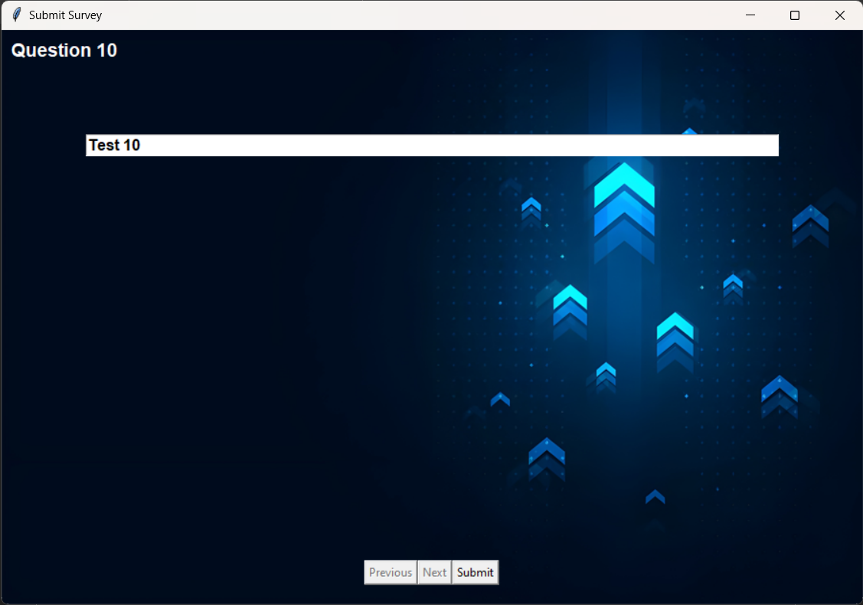
Show the last question of the survey along with the previous next and submit buttons to move between the questions and to assign the survey for the employees to fill it.

Slide 31
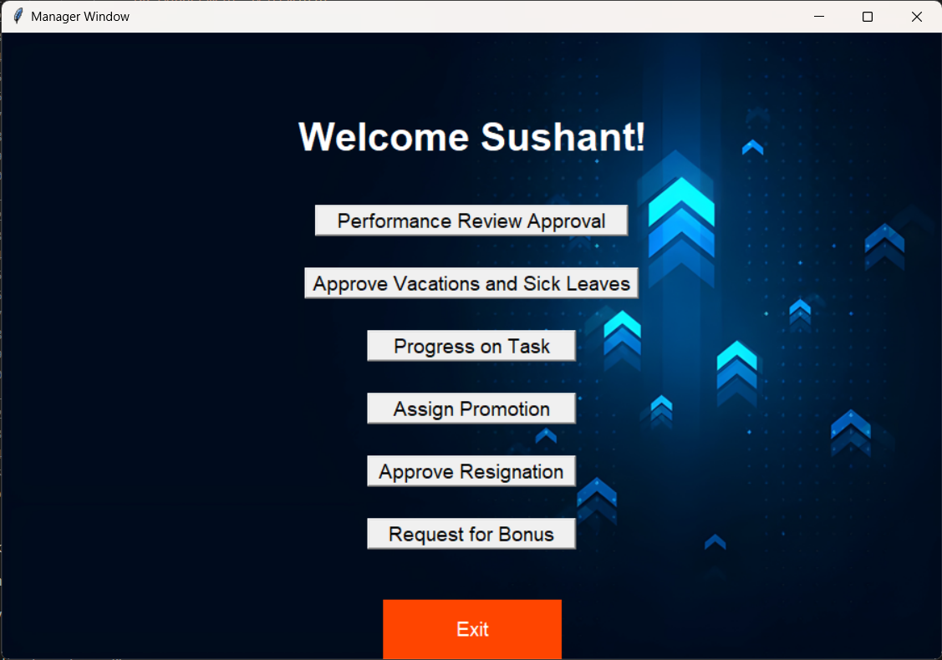
The window that is shown to the user who logs in at the manager level, the user has the options to approve performance reviews, approve vacation/sick leaves, check progress on tasks which are in progress by employees, assign promotions, approve resignation and request for bonus for employees

Slide 32
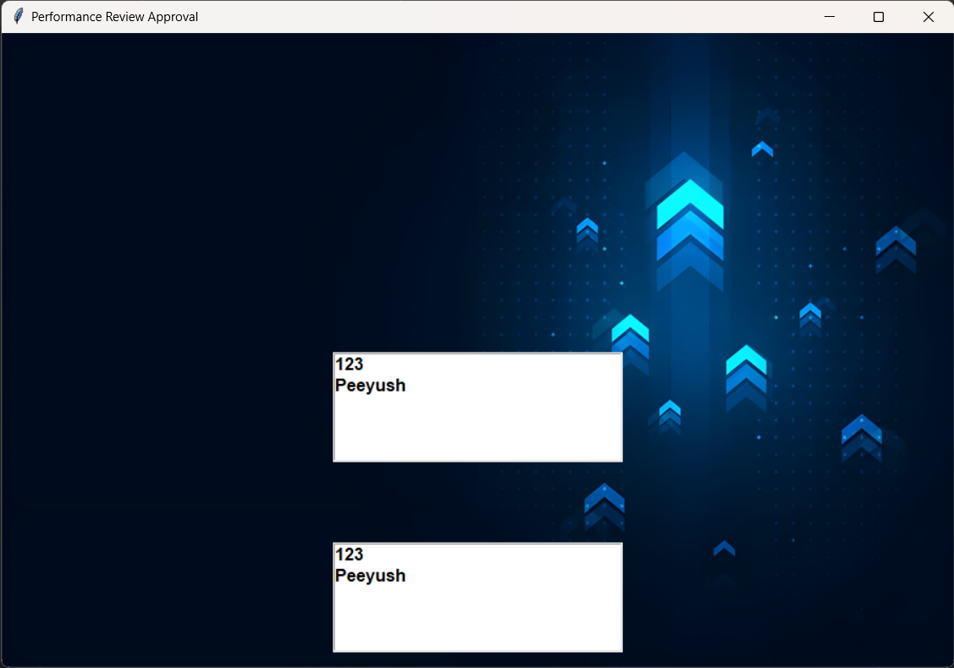
Opens a new window when the approve performance review button is clicked, this displays the list of employees who have filled their quarterly and annual reports separately, clicking each employee’s name will give the information they have filled, that performance review can then be approved or denied by the manager.

Slide 33
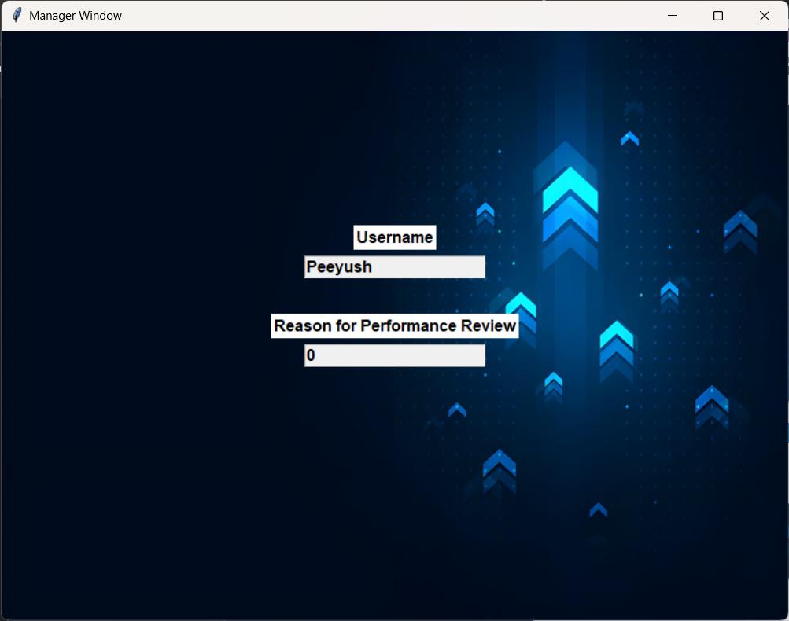
Shows the details of the performance review filled in by the employee along with approve and deny buttons for the performance review.

Slide 34
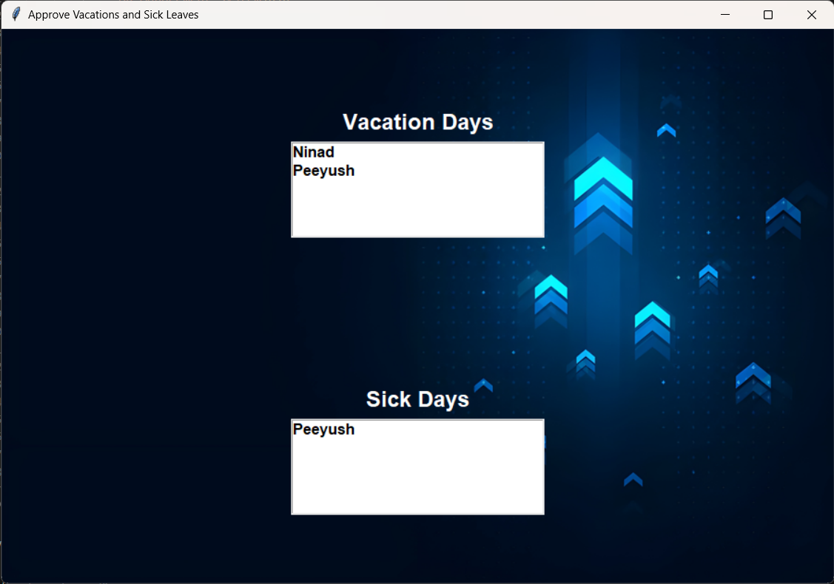
The list of employees whose vacation and sick leave approvals are still pending will be shown in separate list here, the Manager can then click on each user’s name and view the details filled in

Slide 35
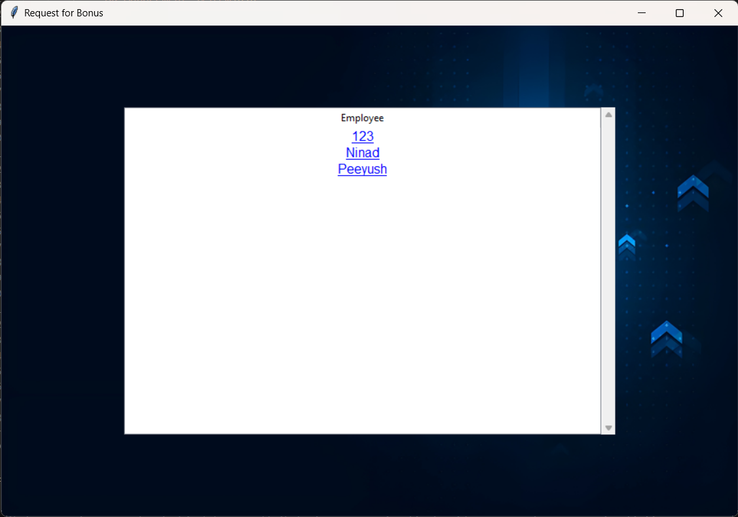
When the Request for bonus button is clicked a new window is created which gives the list for the employees which are clickable, upon clicking that window a new window is further created

Slide 36
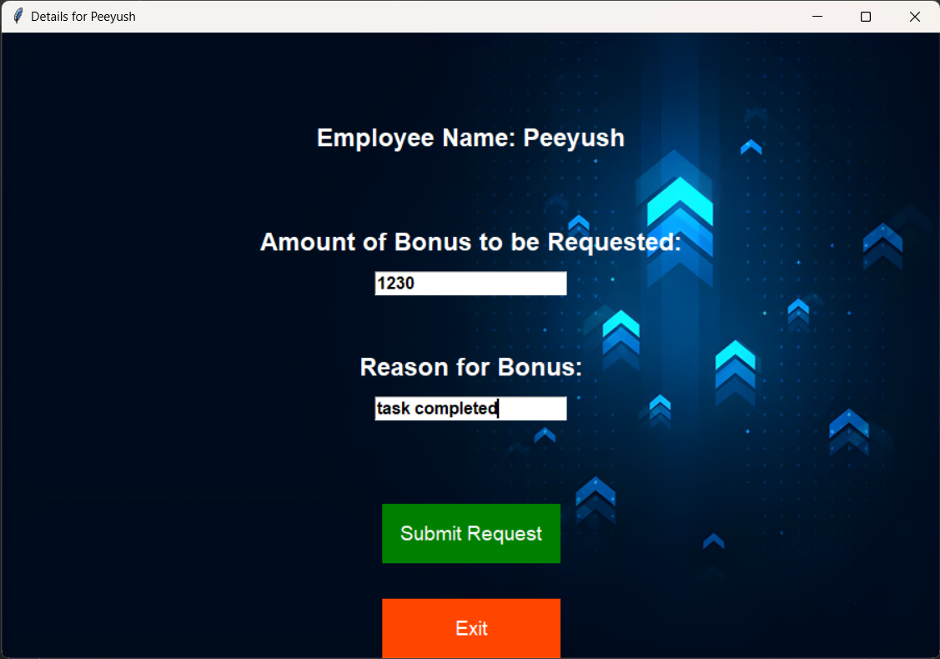
This new window gives the option for the amount of bonus to be requested by the manager for the employee along with the reason for this. There are also two buttons to submit the request or exit from that window.

Slide 37
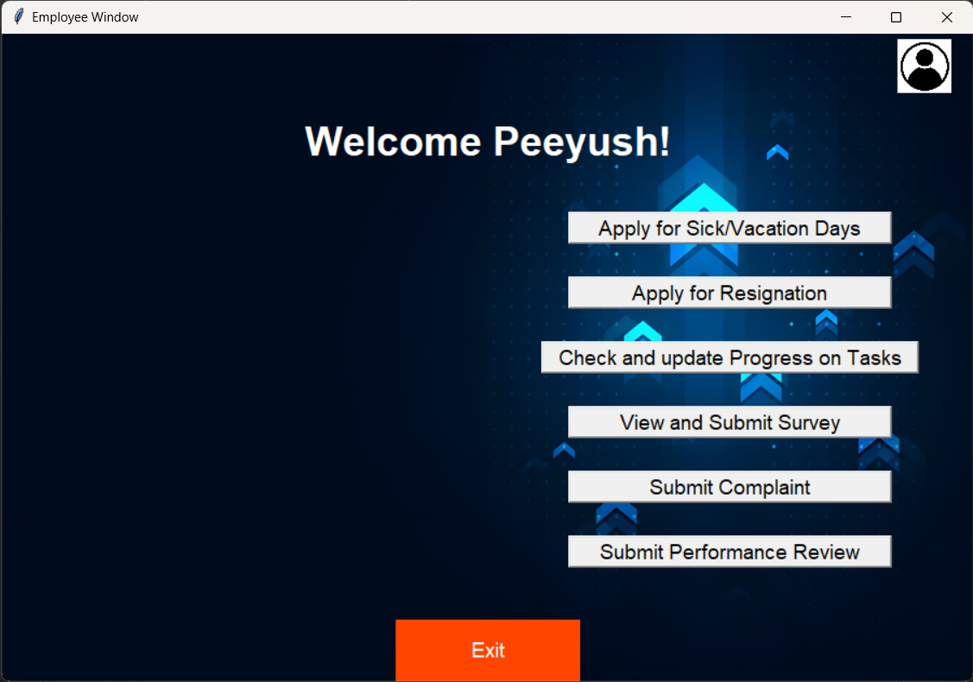
The window shown to the employee role and permission level, it consists of options to Apply for sick/vacation days, apply for resignation, check and update progress on tasks, view and submit surveys created by the HR, submit complaints of various things and submit their own performance review.

Slide 38
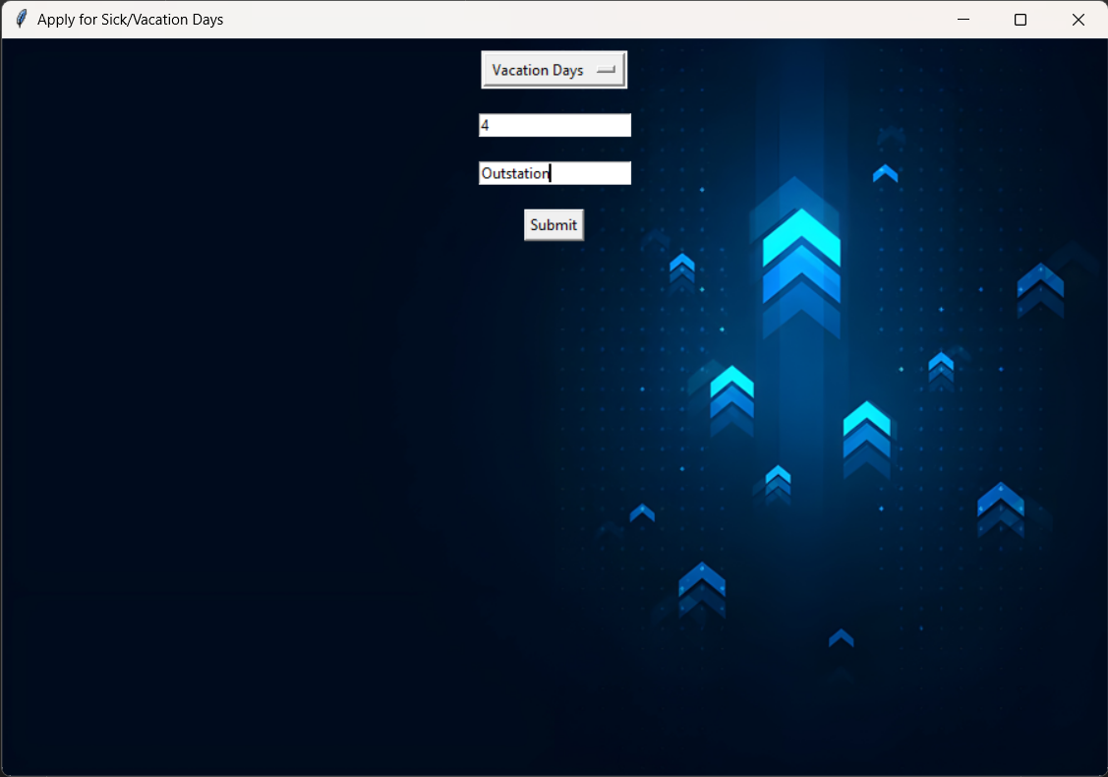
This window is opened when the employee clicks on the Apply for Sick/Vacation days button, it gives the employee the options to choose between the sick and vacation days request along with the number of days to be requested and the reason for the request.

Slide 39
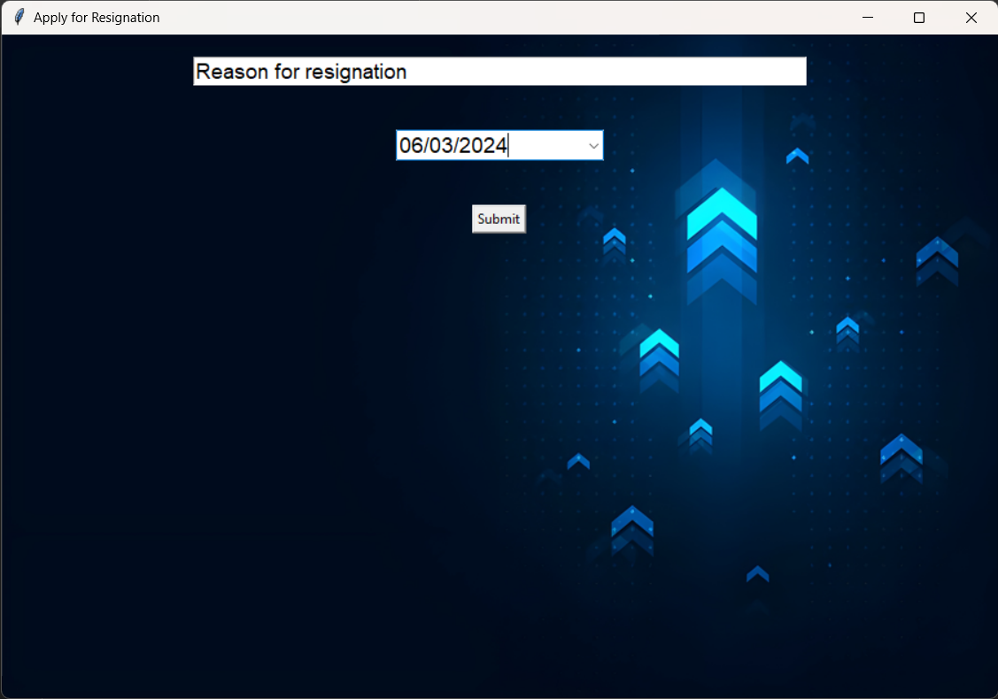
The window shown when the user clicks on the apple for resignation button, which ask the user for the to apply for resignation (minimum 2 weeks notice) along with the reason for the resignation and a submit button to submit the request.

Slide 40
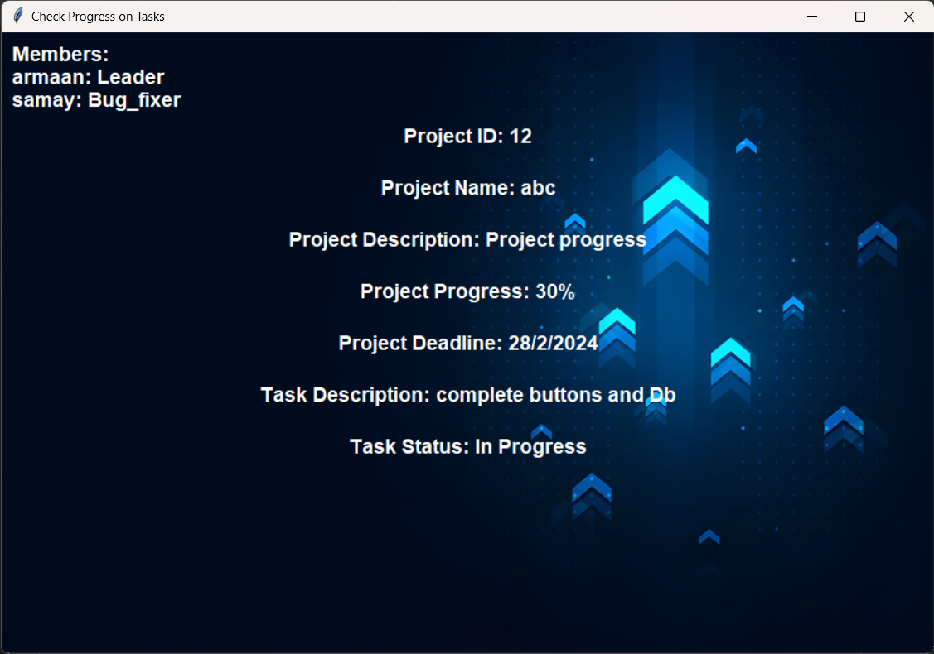
The window shown when the employee clicks on the check progress on task button, it also gives the option to update the progress and mark the task as completed.

Slide 41
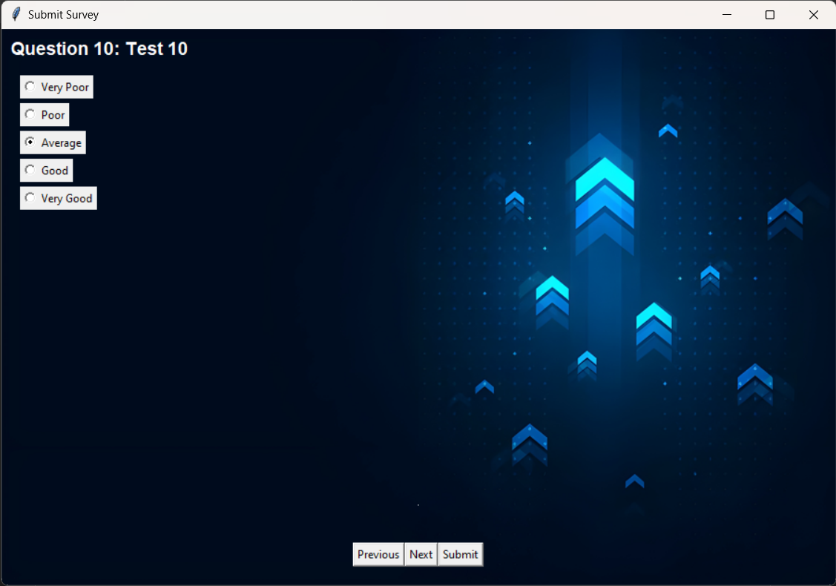
The window shown when the user clicks on the submit survey button to fill the survey set by the HR for the employees. The questions are displayed along with the question number and the radio buttons for the options, at the bottom of the window there are 3 more buttons for previous, next and submit.

Slide 42
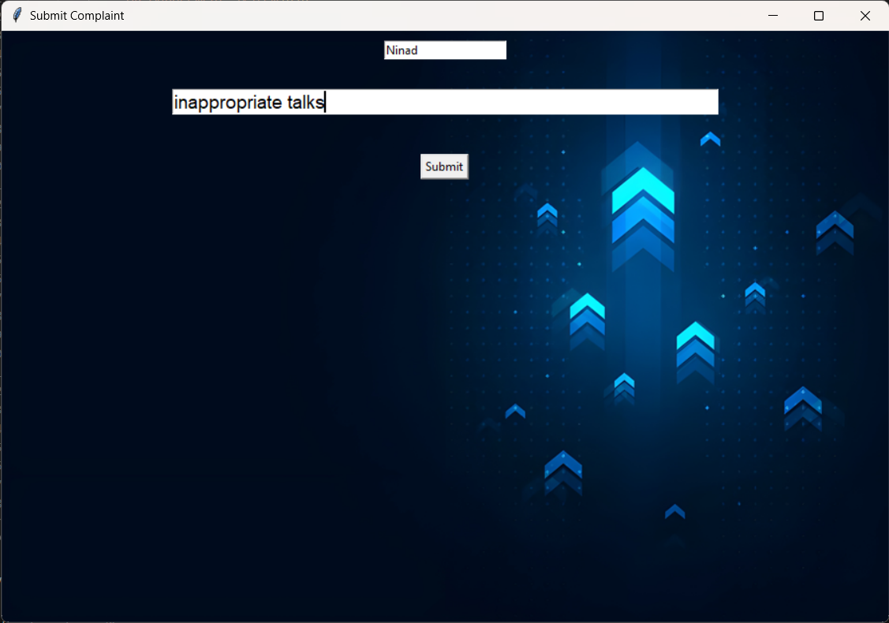
When an employee clicks on the submit complaint button this window is created which gives 2 input boxes for the name of the employee along with the reason for the complaint, after the two input boxes there is a submit button.

Slide 43
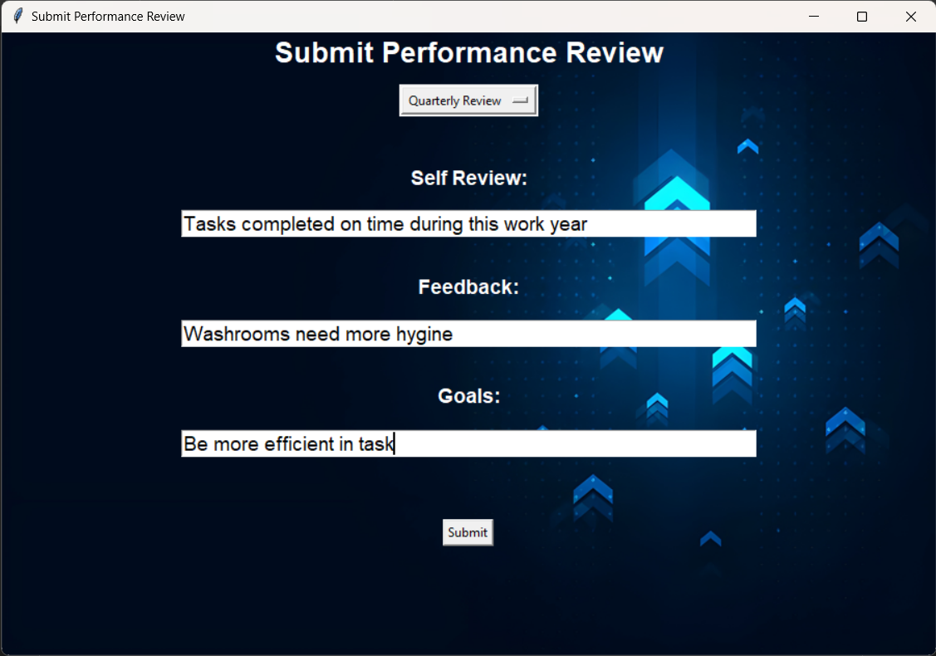
When the Submit performance review button is clicked this window is shown to the user which gives the option to select from quarterly review and annual review, along with 3 input boxes for their self review, feedback for the company and future self goals, below the input boxes is a submit button.

Slide 44
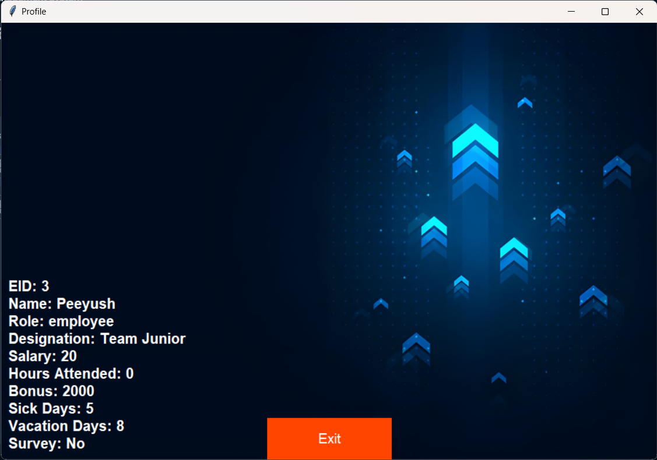
This is a common window shown for HR/Manager/Employee when the profile button is clicked at the top right of the main window after putting the login details and successful login.

Slide 45
References
References:
ChatGPT (OpenAI):
i.Useful for resolving technical issues and bug fixes during the project development process.
ii.Website: OpenAI
2. GeeksforGeeks: A valuable resource for generating ideas, solutions to coding challenges, and technical insights. Website: GeeksforGeeks
3. YouTube: A platform to explore a wide range of video tutorials, demonstrations, and insights related to mobile game development and user interface design.
Website: YouTube
4.Overstack: A community-based space to find and contribute answers to technical challenges, and one of the most popular websites in the world.
5.GitHub: It is a developer platform that allows developers to create, store, manage and share their code. It uses Git software, providing the distributed version control of Git plus access control, bug tracking, software feature requests, task management, continuous integration, and wikis for every project.
The Github Repository of this Project with the Source code, Project Report and a copy of this PPT can be found at: https://github.com/Armaan4477/Backup-MP4

Slide 46
Thank You!!!

